Slide 1
Apple inc. Stock Price Prediction
Yulun Han
MACS 30100
Notes:
My project is apple stock price prediction

Slide 2
Task
Task 1: According to the research paper, analyze EMA and SMA which is best feature to forecast stock price by applying the following models.
Linear Regression
Ridge Regression
Lasso Regression
Task 2: Based on the EMA and SMA analysis results, to predict the APPL stock price in the following three models.
Linear Regression
Prophet
Long Short-Term Memory (LSTM)
Research Paper:
“EMA versus SMA Usage to Forecast Stock Markets: the Case of S&P 500 and OMX Baltic Benchmark”
https://doi.org/10.3846/btp.2010.27
Notes:
this project has two tasks
the first task is...
the model i applied are linear ridge and lasso regression
the second task is ...
I applied linear regression, prophet and long short term memory models
and here is the citation of the research paper

Slide 3
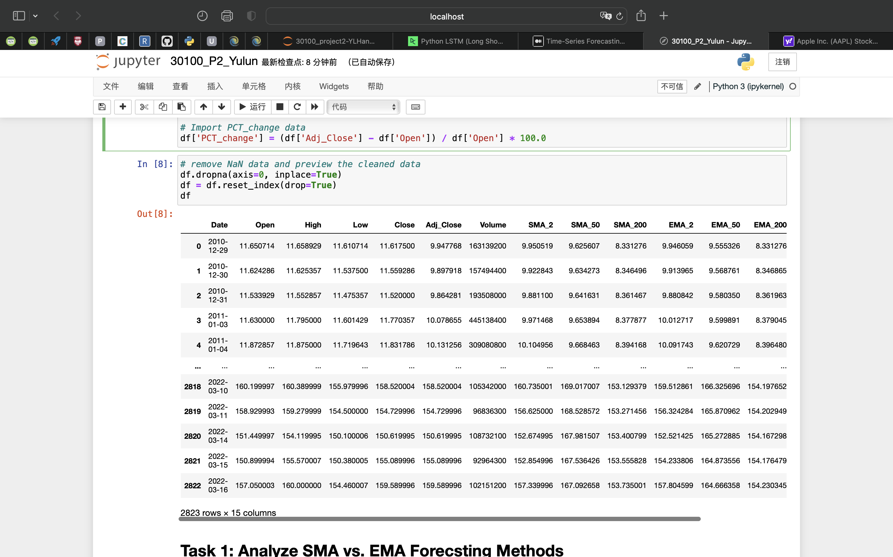
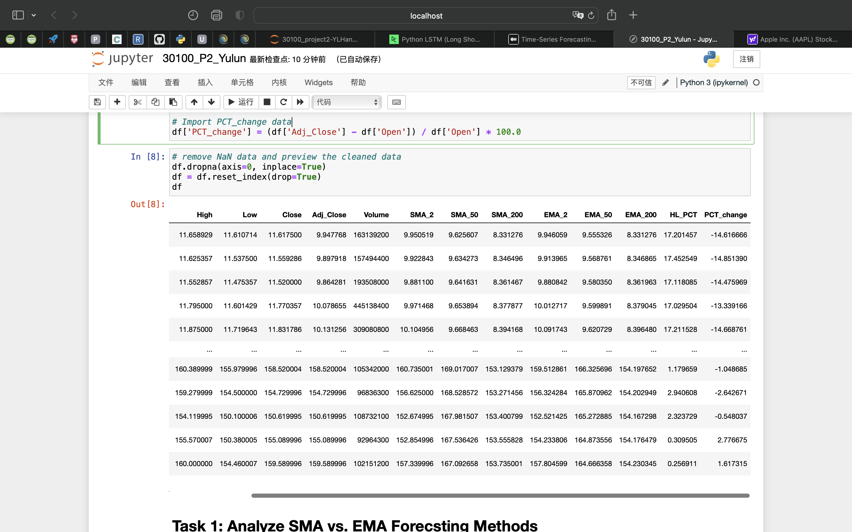
Data
Data size:
42,345
2823 rows x 15 columns
Split the data into 70% training and 30% testing
Features: 15 numerical features in total
Data Preprocessing:
MinMaxScaler
Notes:
After cleaning dataset, it contains 2823 rows and 15 columns. The data size is 42,345.
And, I splited data into 70% training and 30% testing in every models
in the data analysis, i will use 15 features. and all of 15 features are numerical.
For data preprocessing part, I applied minmax scaler

Slide 4
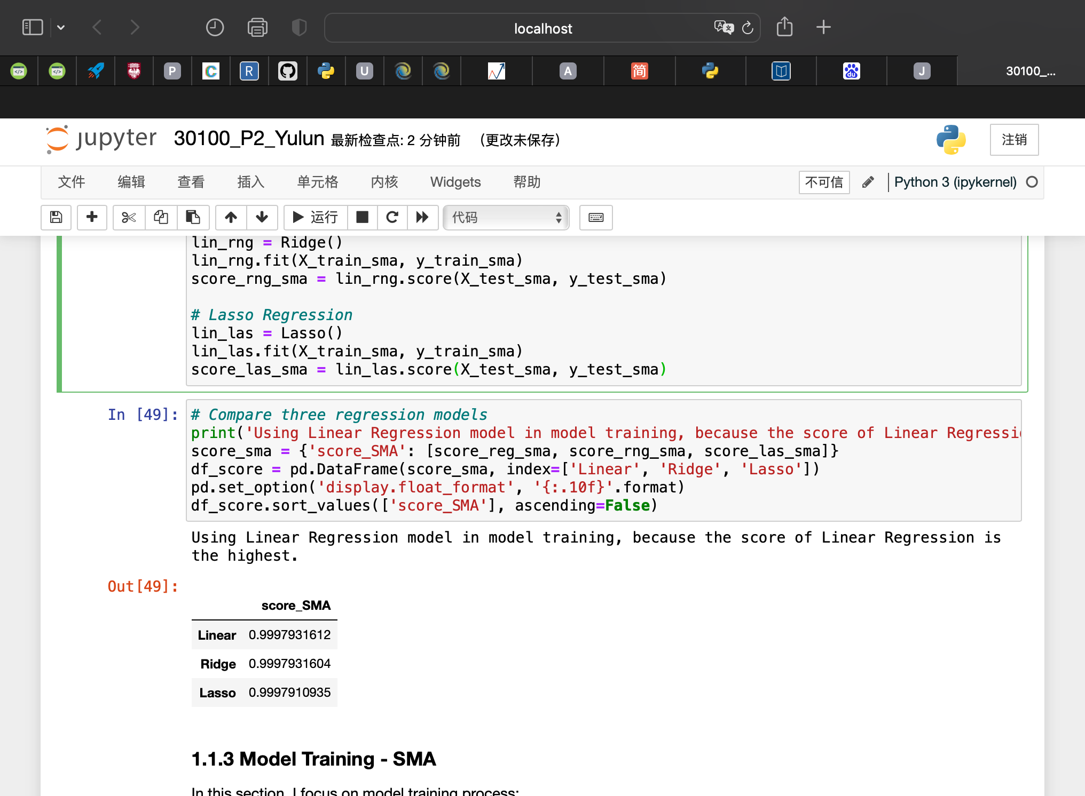
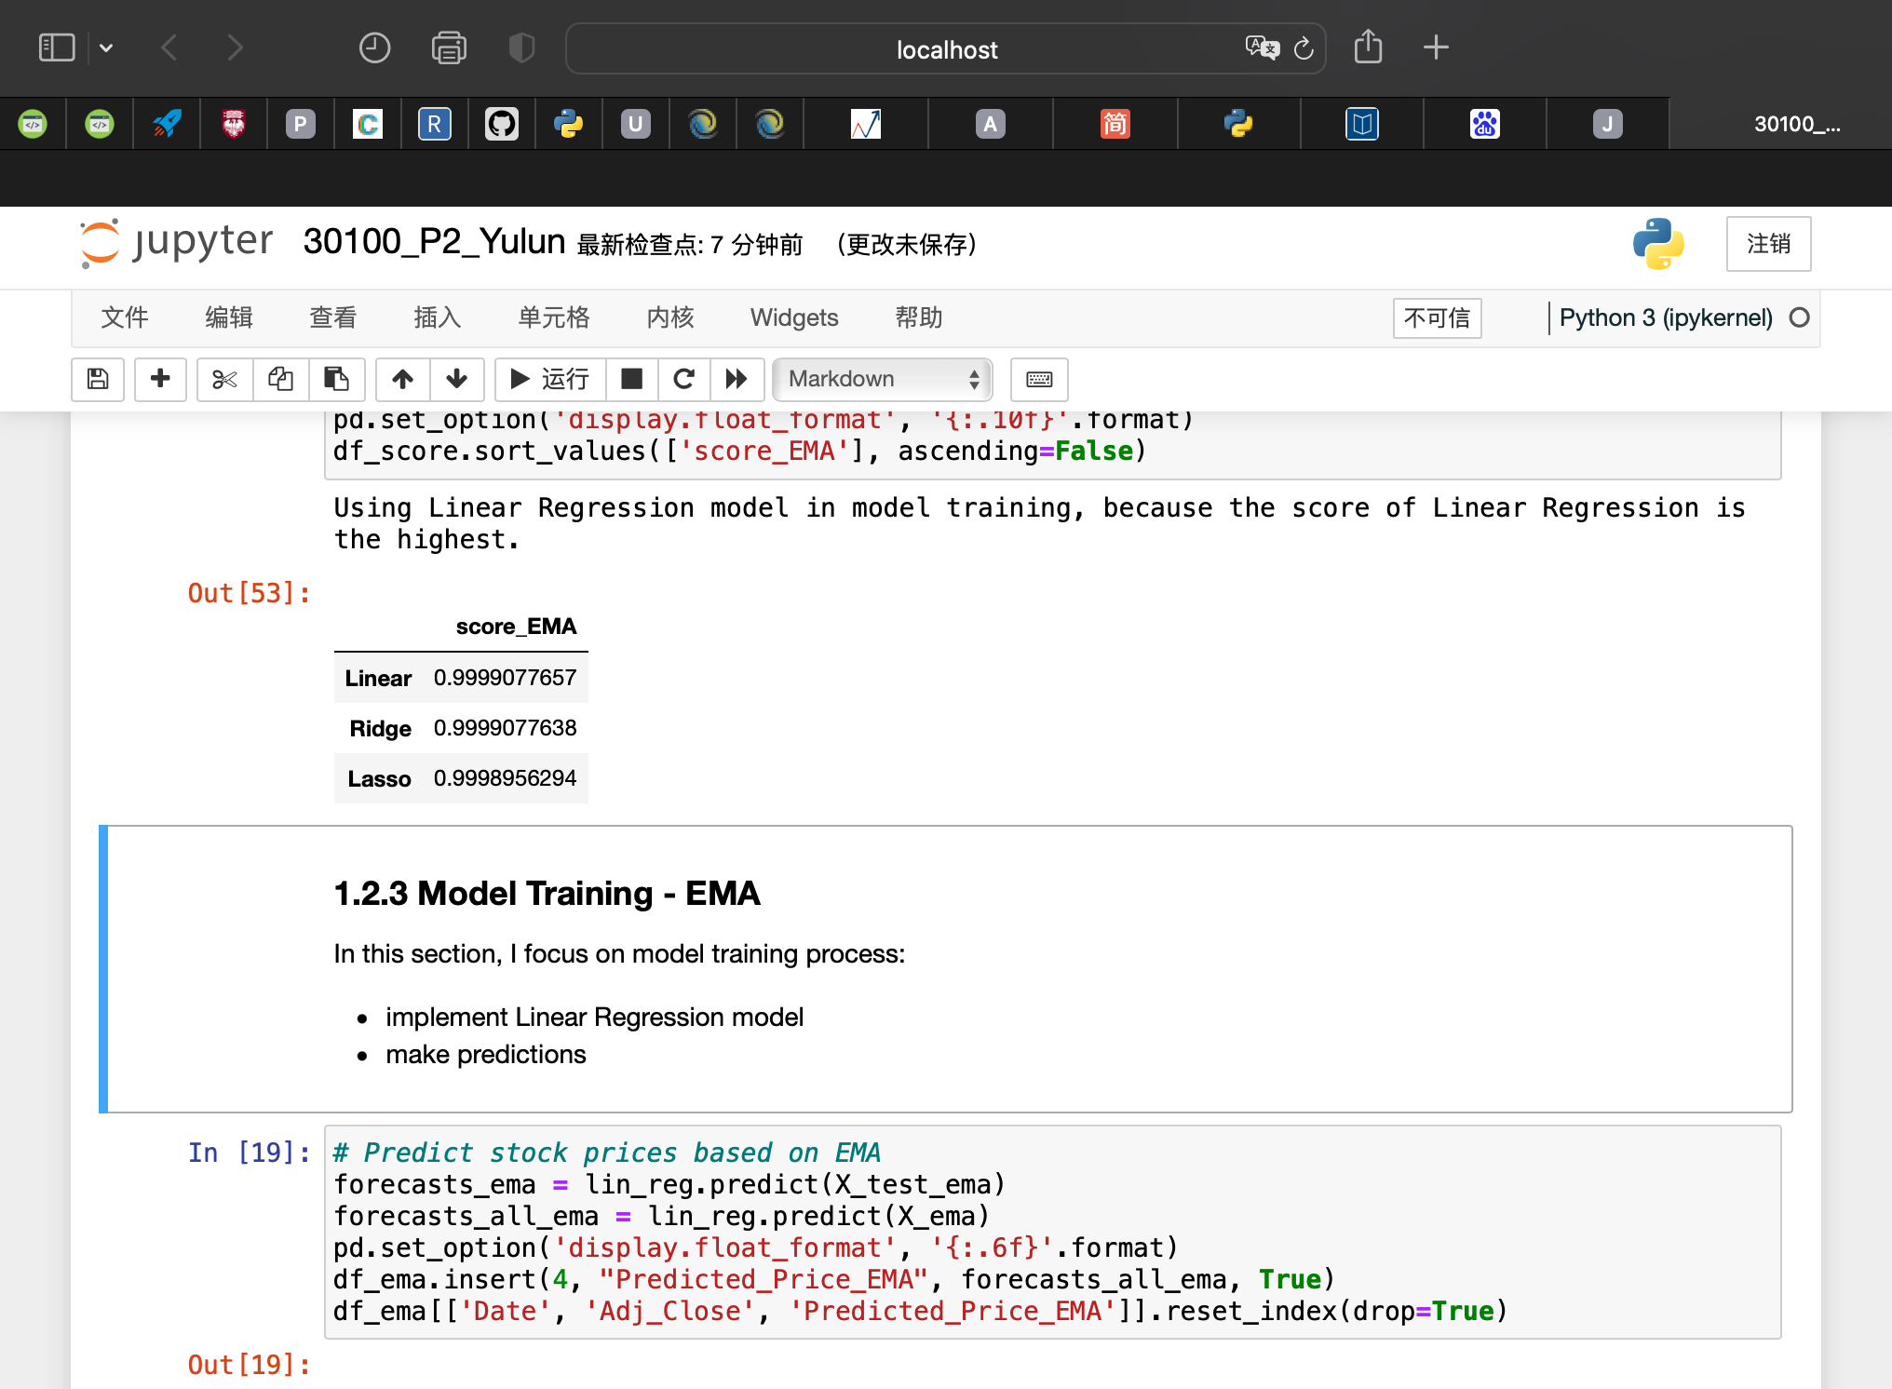
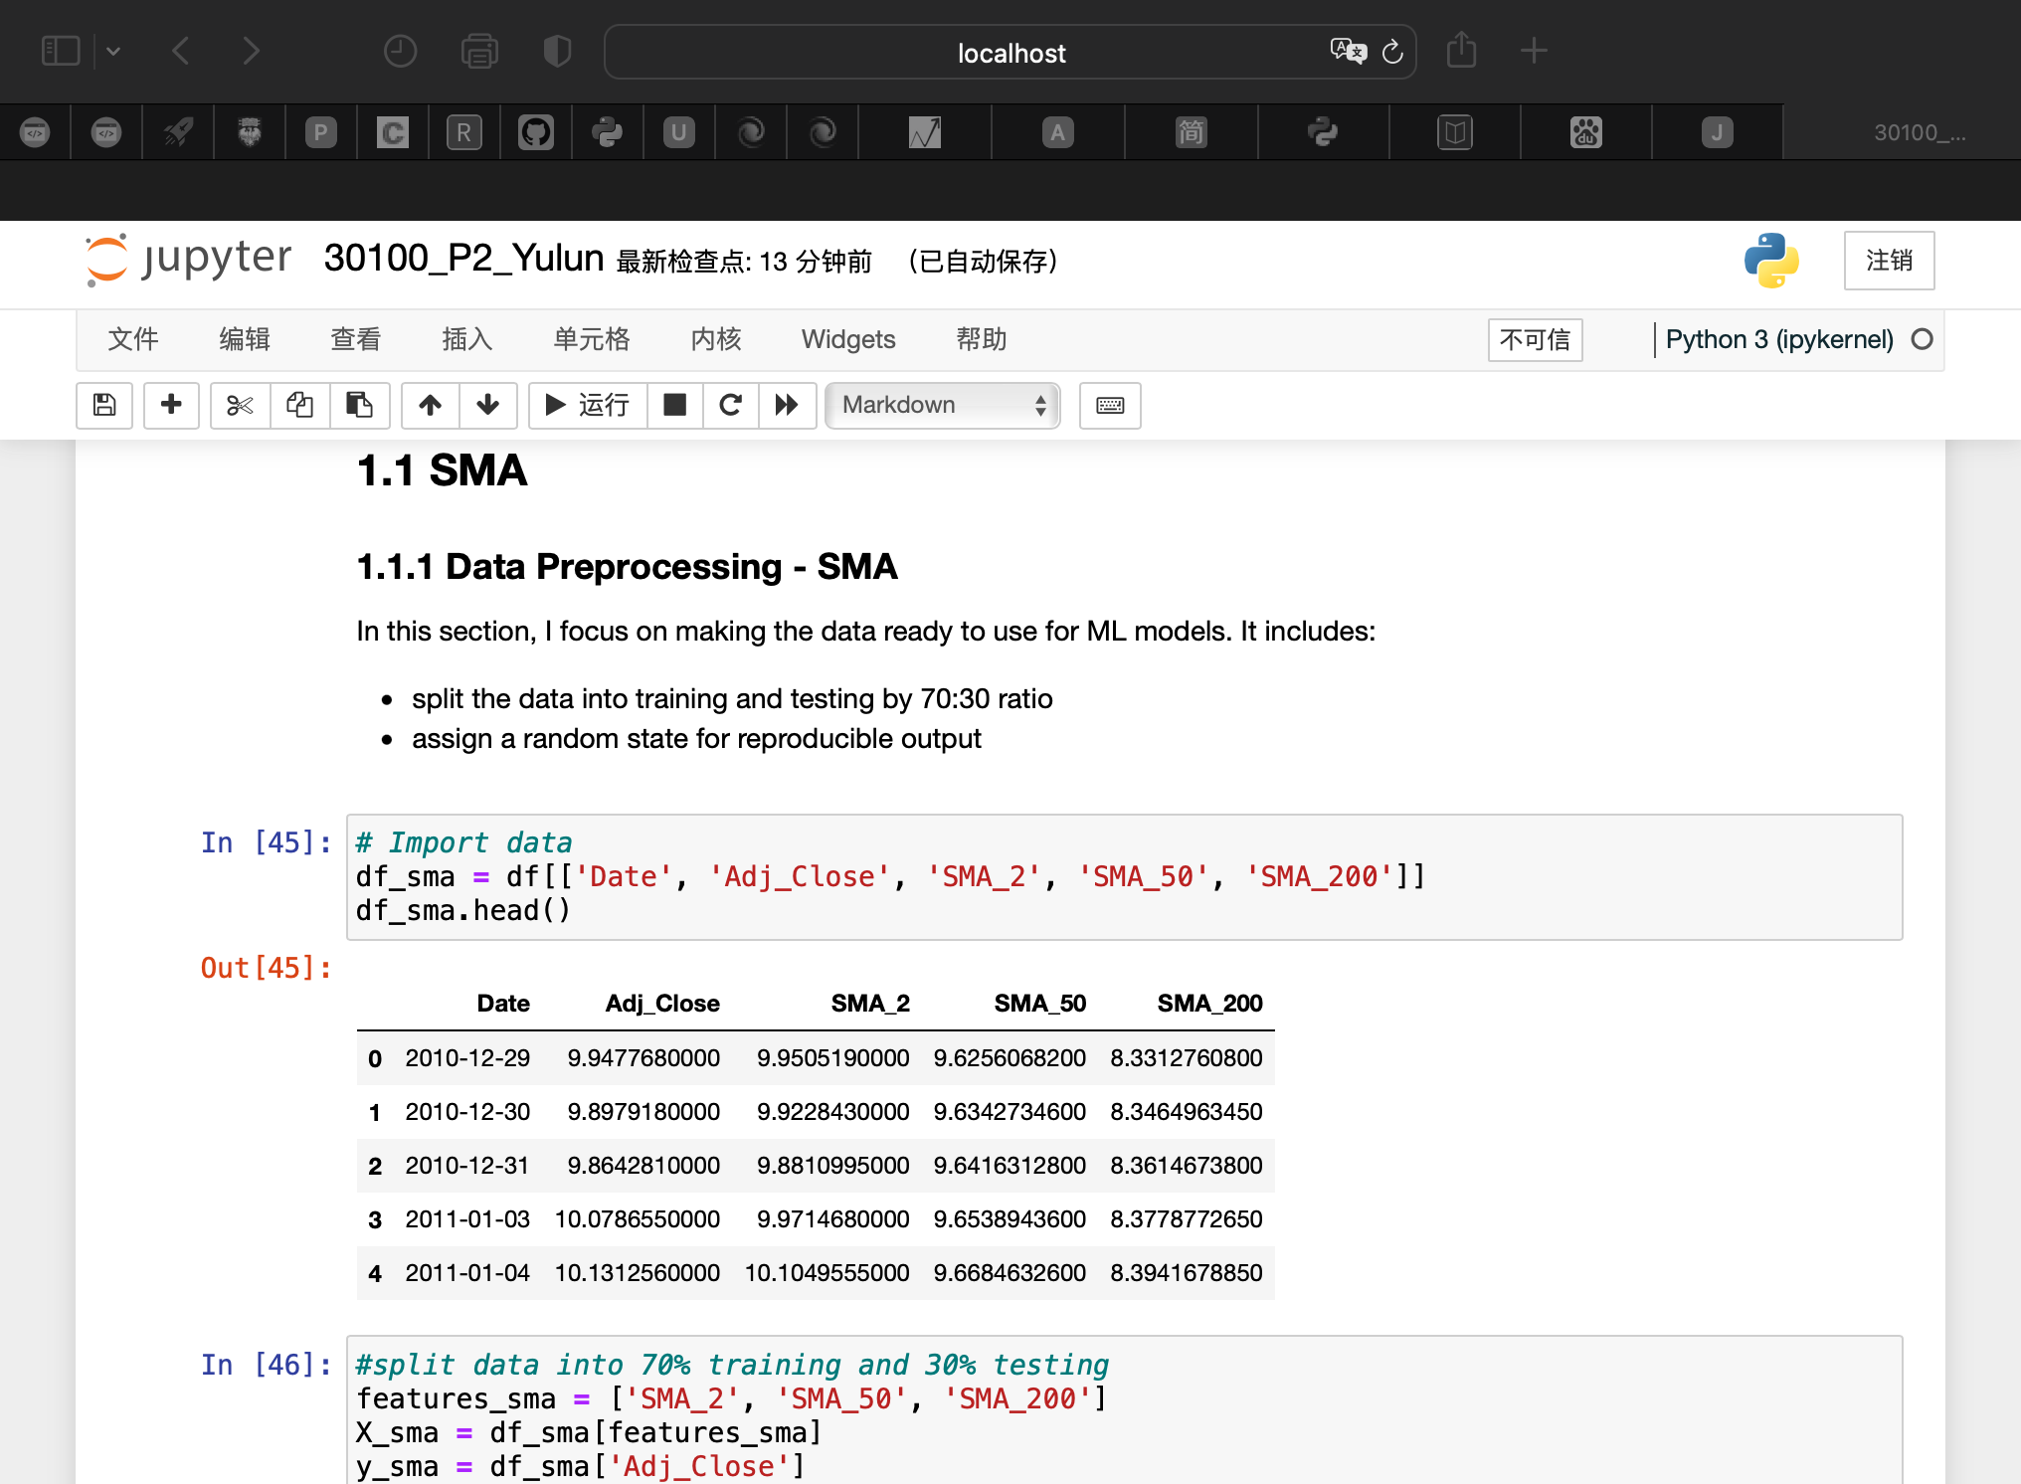
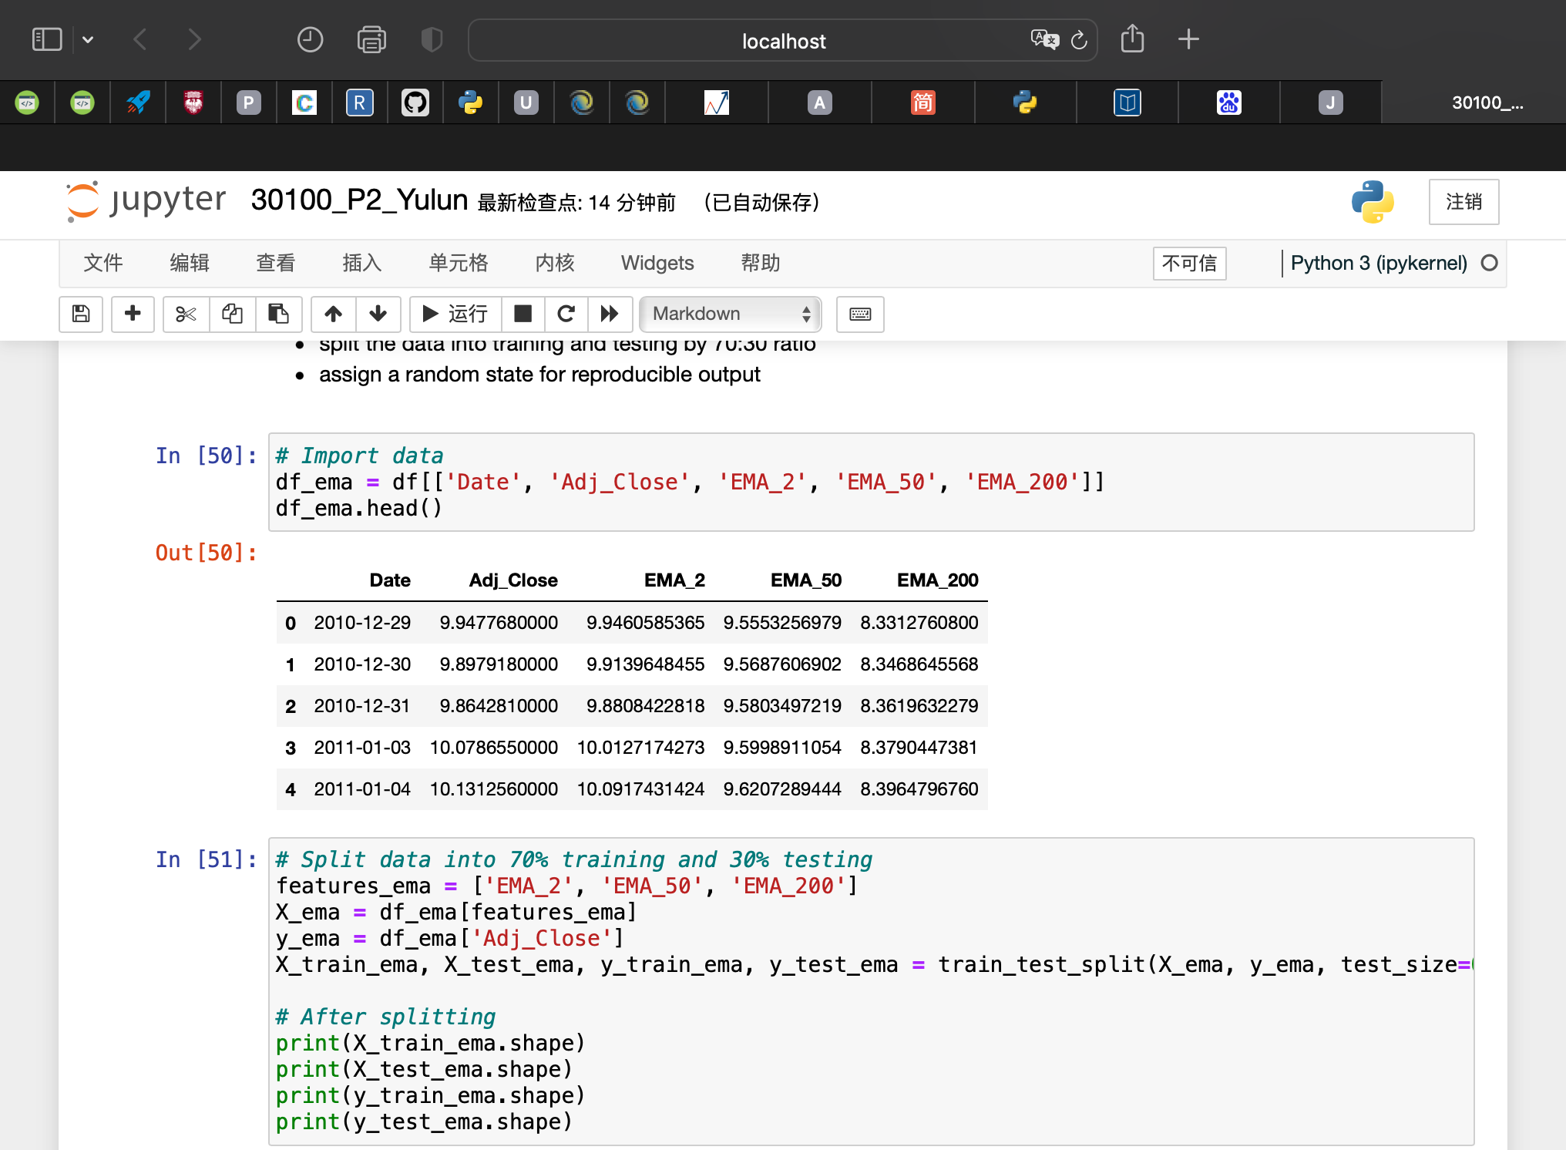
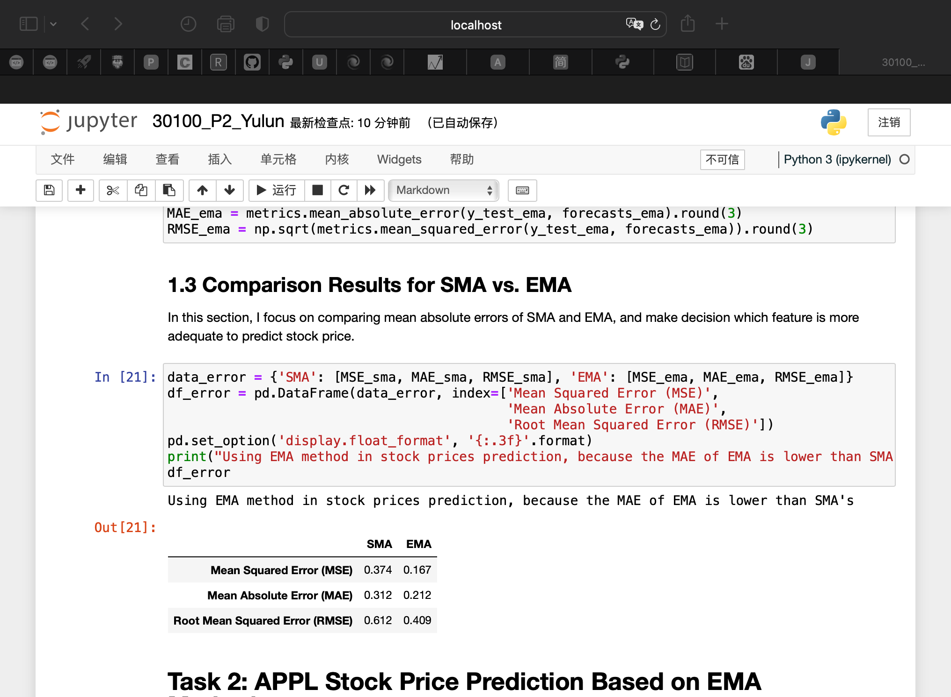
Task 1 - Analyze SMA vs. EMA Forecasting Methods
Features:
‘SMA_2’, ‘SMA_50’, ‘SMA_200’
‘EMA_2’, ‘EMA_50’, ‘EMA_200’
Model Selection
Compared the scores of Linear/Ridge/Lasso regression models
decide to apply Linear regression model
Error Analysis
The MAE of EMA is lower than SMA’s
Using EMA method in stock price prediction
Notes:
for the first task
鼠标
i adjust features
when analyzing SMA, i use sma_2, sma_50 and sma_200 as the features
when analyzing EMA, i use ema_2, ema_50 and ema_200 as the features
鼠标
鼠标
for model selection, i compared score of 3 models, and i found out Linear reg has the highest score, so i decide to use linear reg
after model training, i create error analysis 鼠标
compared error analysis of SMA and EMA, The mean absolute error of EMA is lower than SMA’s
so, i will use EMA in the stock price prediction

Slide 5
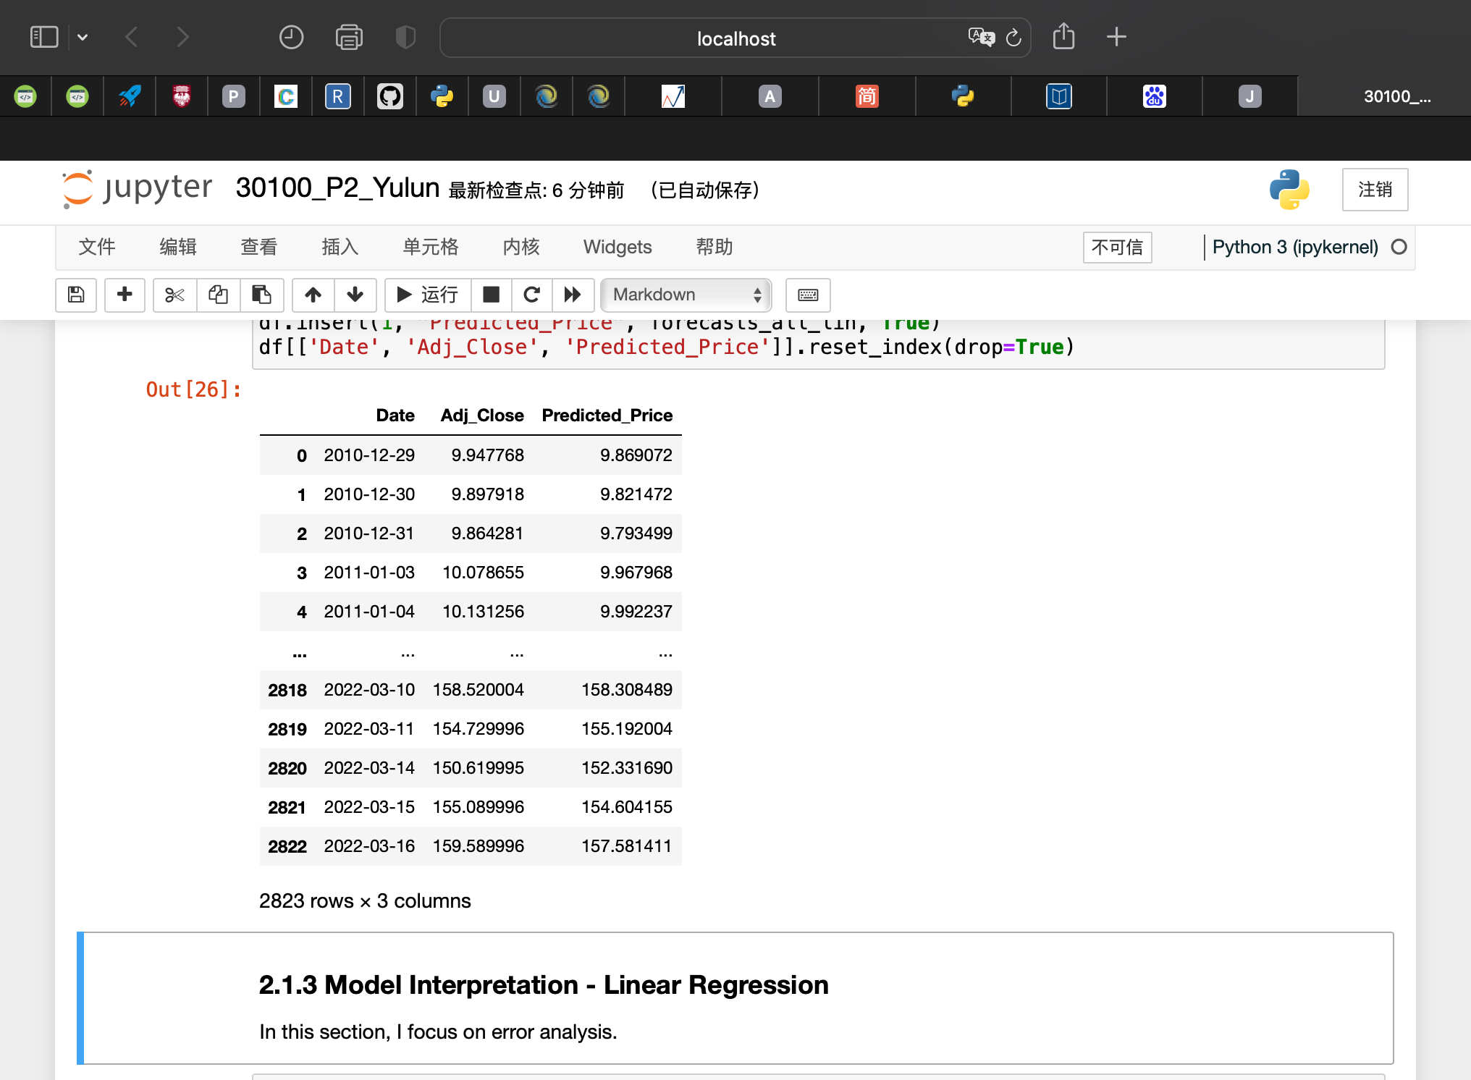
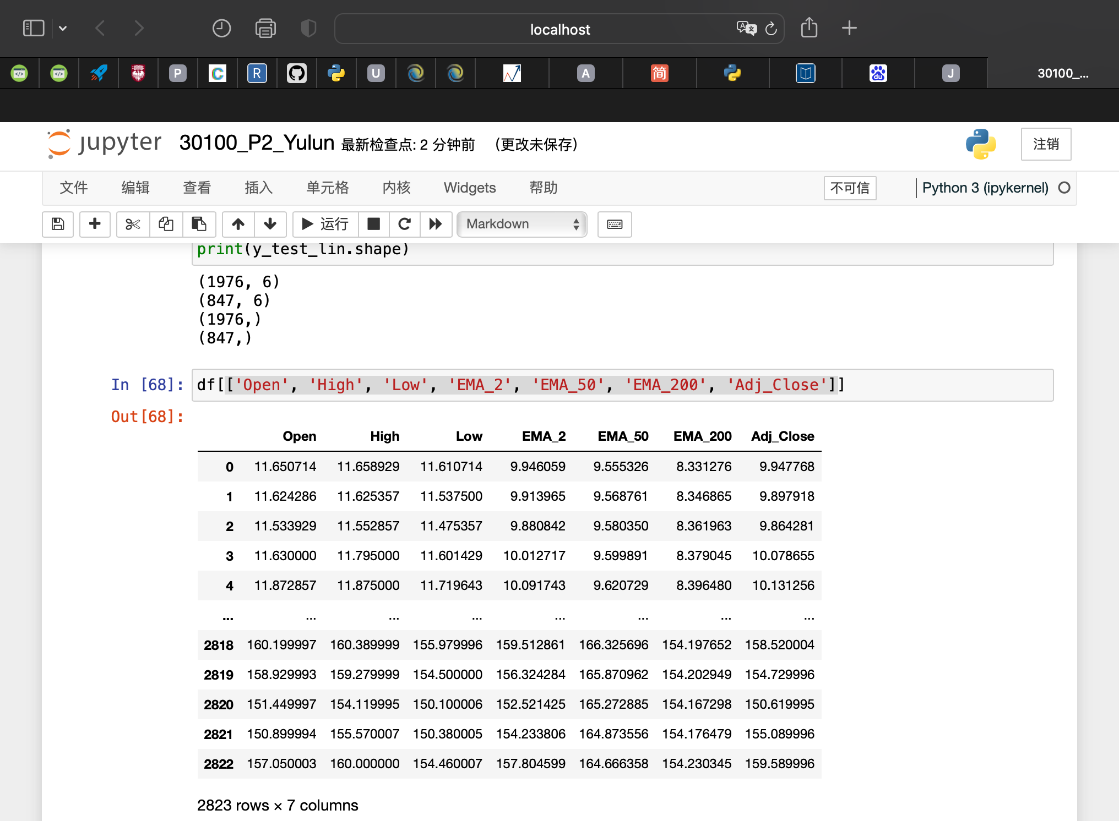
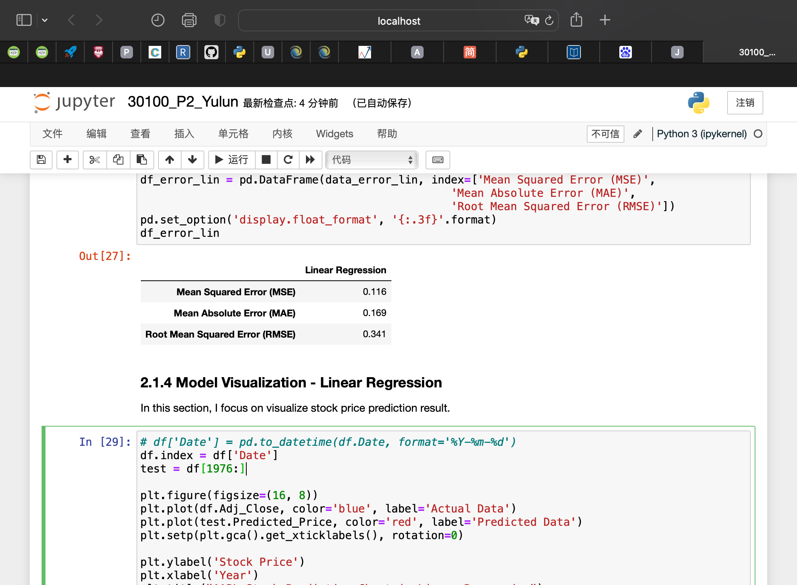
Task 2: APPL Stock Price Prediction - Linear Regression
Features:
‘Open’, ‘High’, ‘Low’, ‘EMA_2’, ‘EMA_50’, ‘EMA_200’
Stock Prediction
Error Analysis
Notes:
for the second task
the first model i applied is Linear reg
i adjust features based on first task analysis result
i use ... as festures
鼠标
鼠标
and then i did stock prediction
鼠标
also i create error analysis

Slide 6
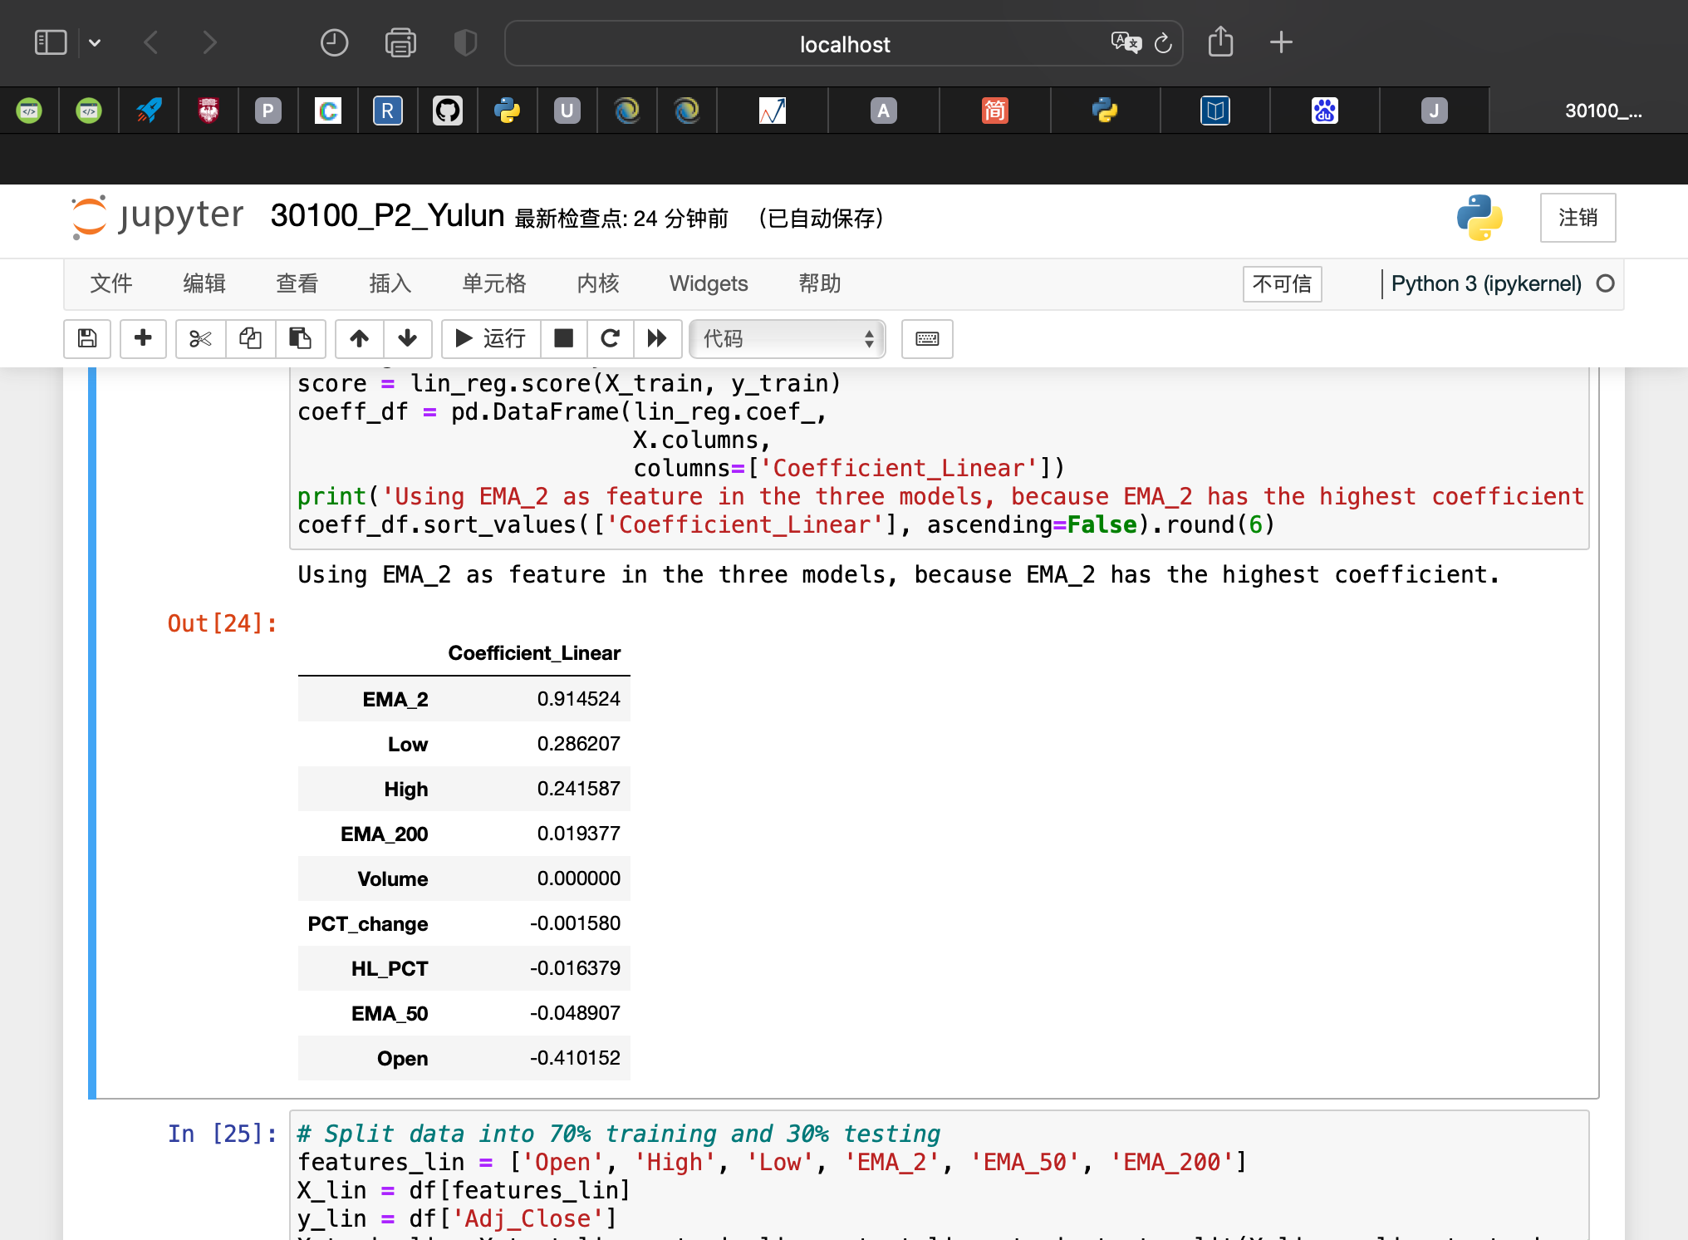
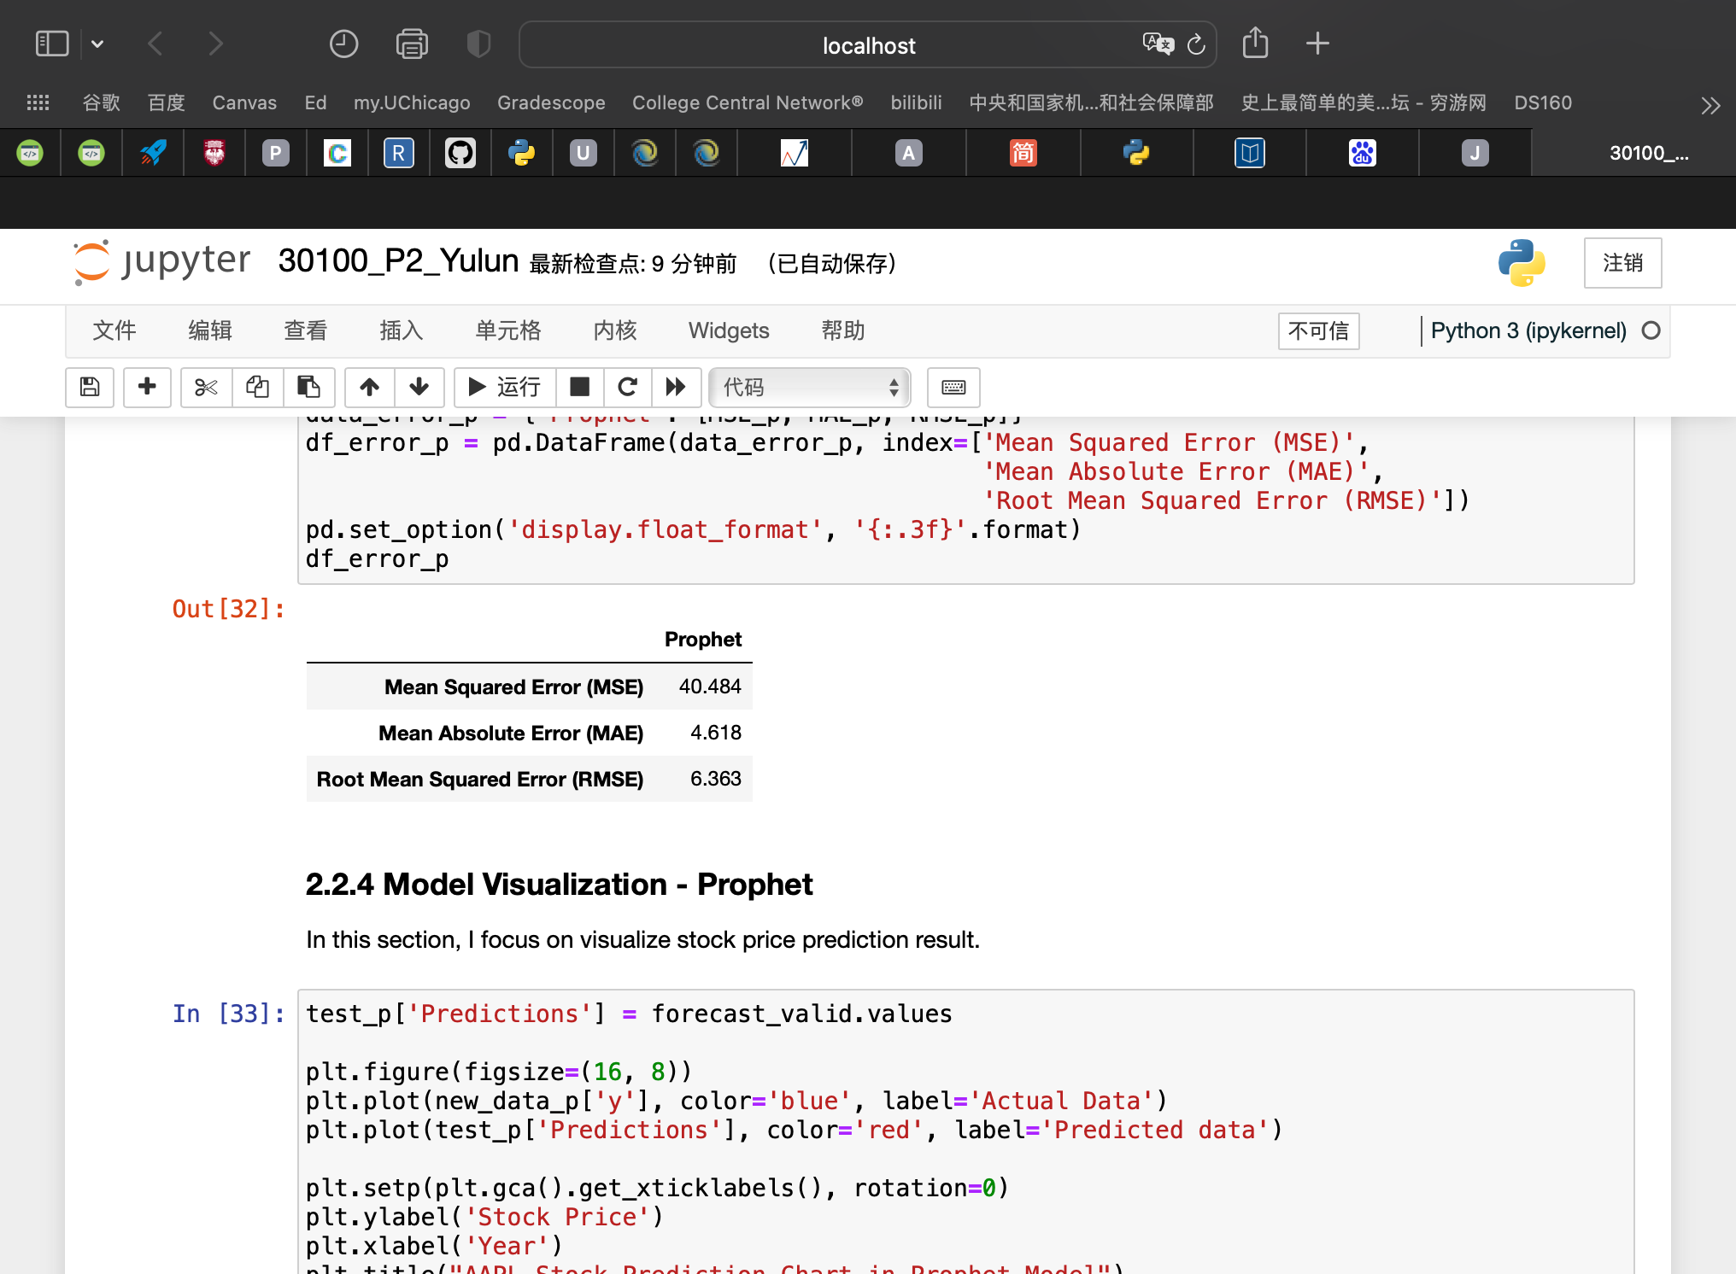
Task 2: APPL Stock Price Prediction – Prophet
Features:
‘Adj_Close’, ‘EMA_2’
Stock Prediction
Error Analysis
Notes:
for the second task
the second model i applied is Porphet model
i adjust features based on previous task analysis result
i use ... as festures
and then i did stock prediction
鼠标
also i create error analysis

Slide 7
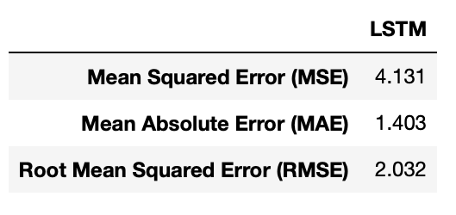
Task 2: APPL Stock Price Prediction – Long Short-Term Memory (LSTM)
Features:
‘Date’, ‘Adj_Close’, ‘EMA_2’
Stock Prediction
Error Analysis
Notes:
for the second task
the last model i applied is long short term memory model
i also adjust features based on first task analysis result
i use ... as festures
and then i did stock prediction and create error analysis

Slide 8
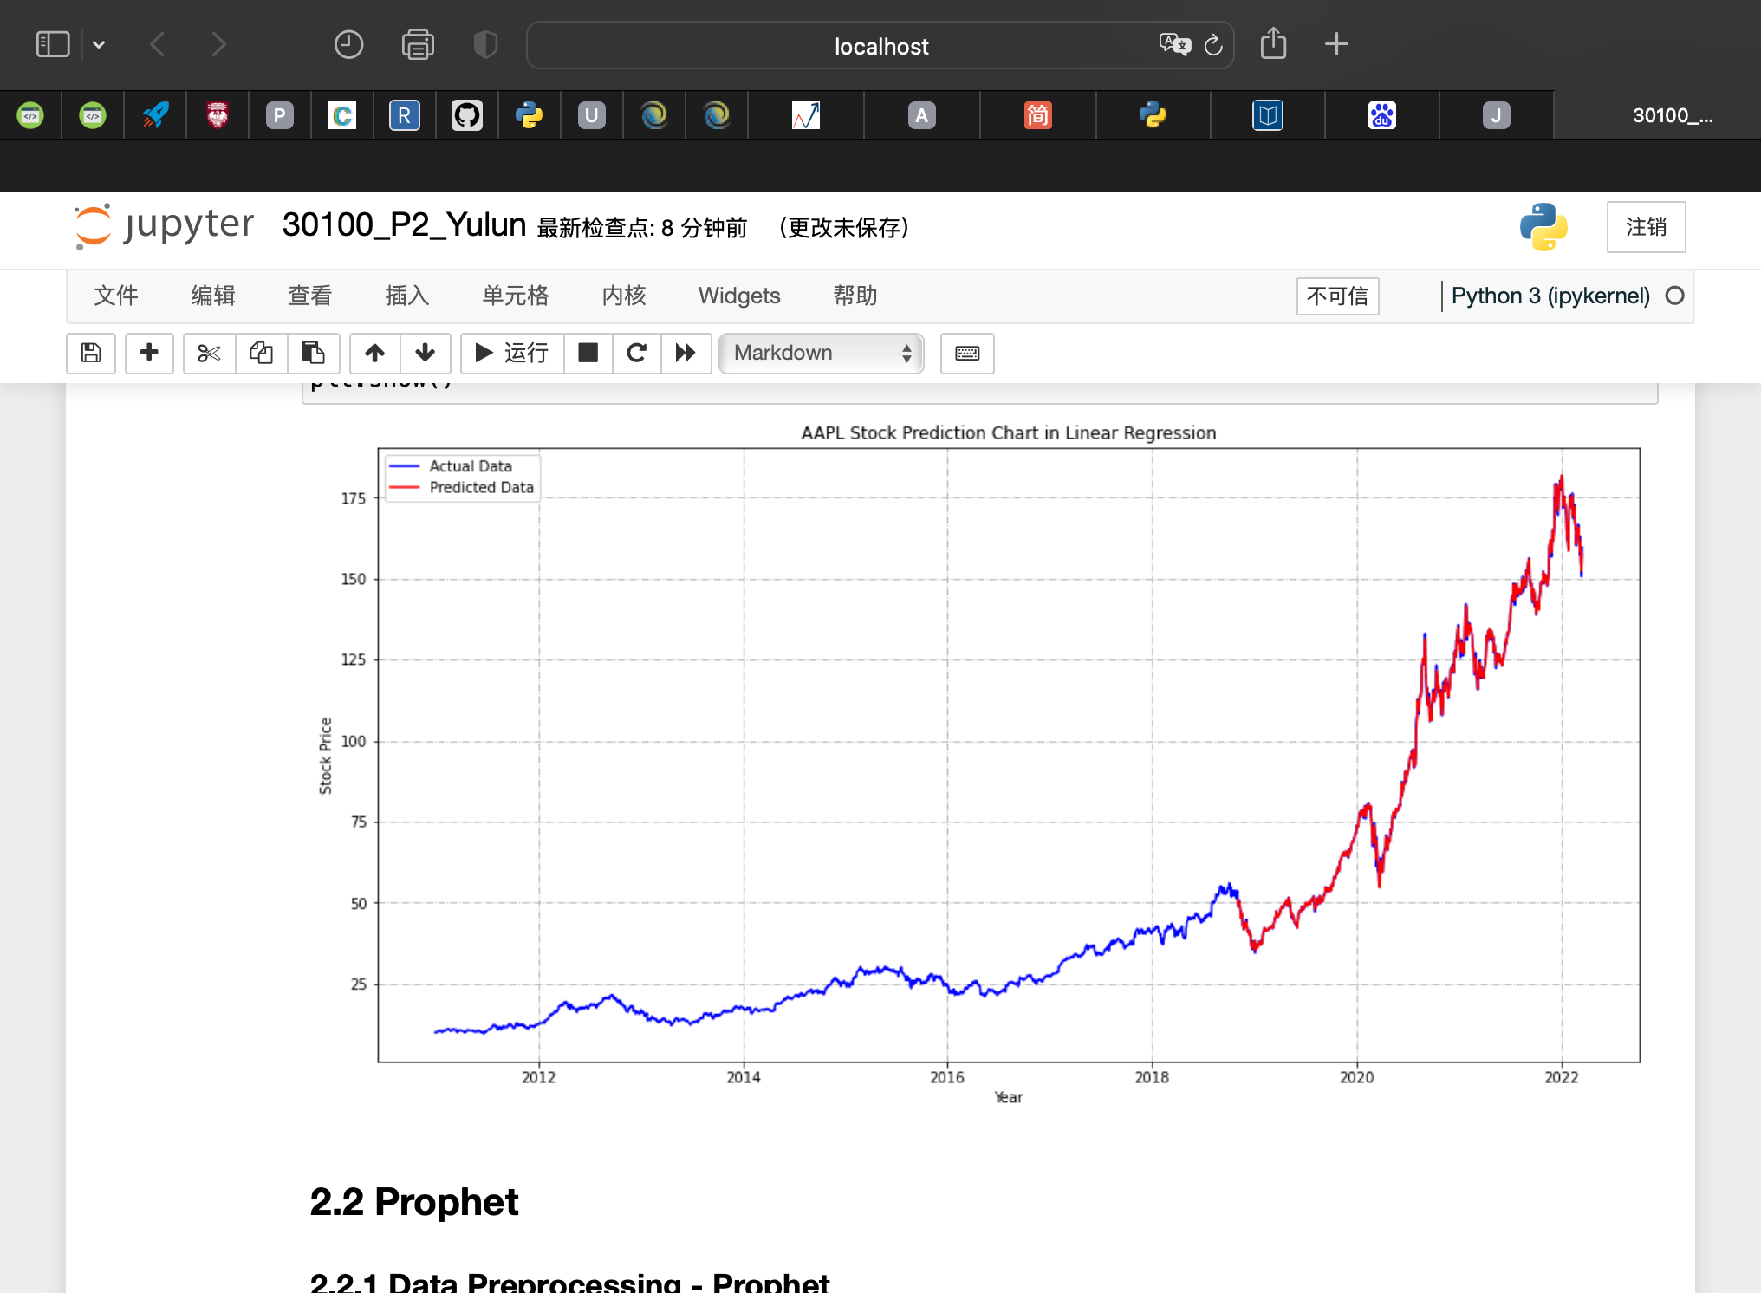
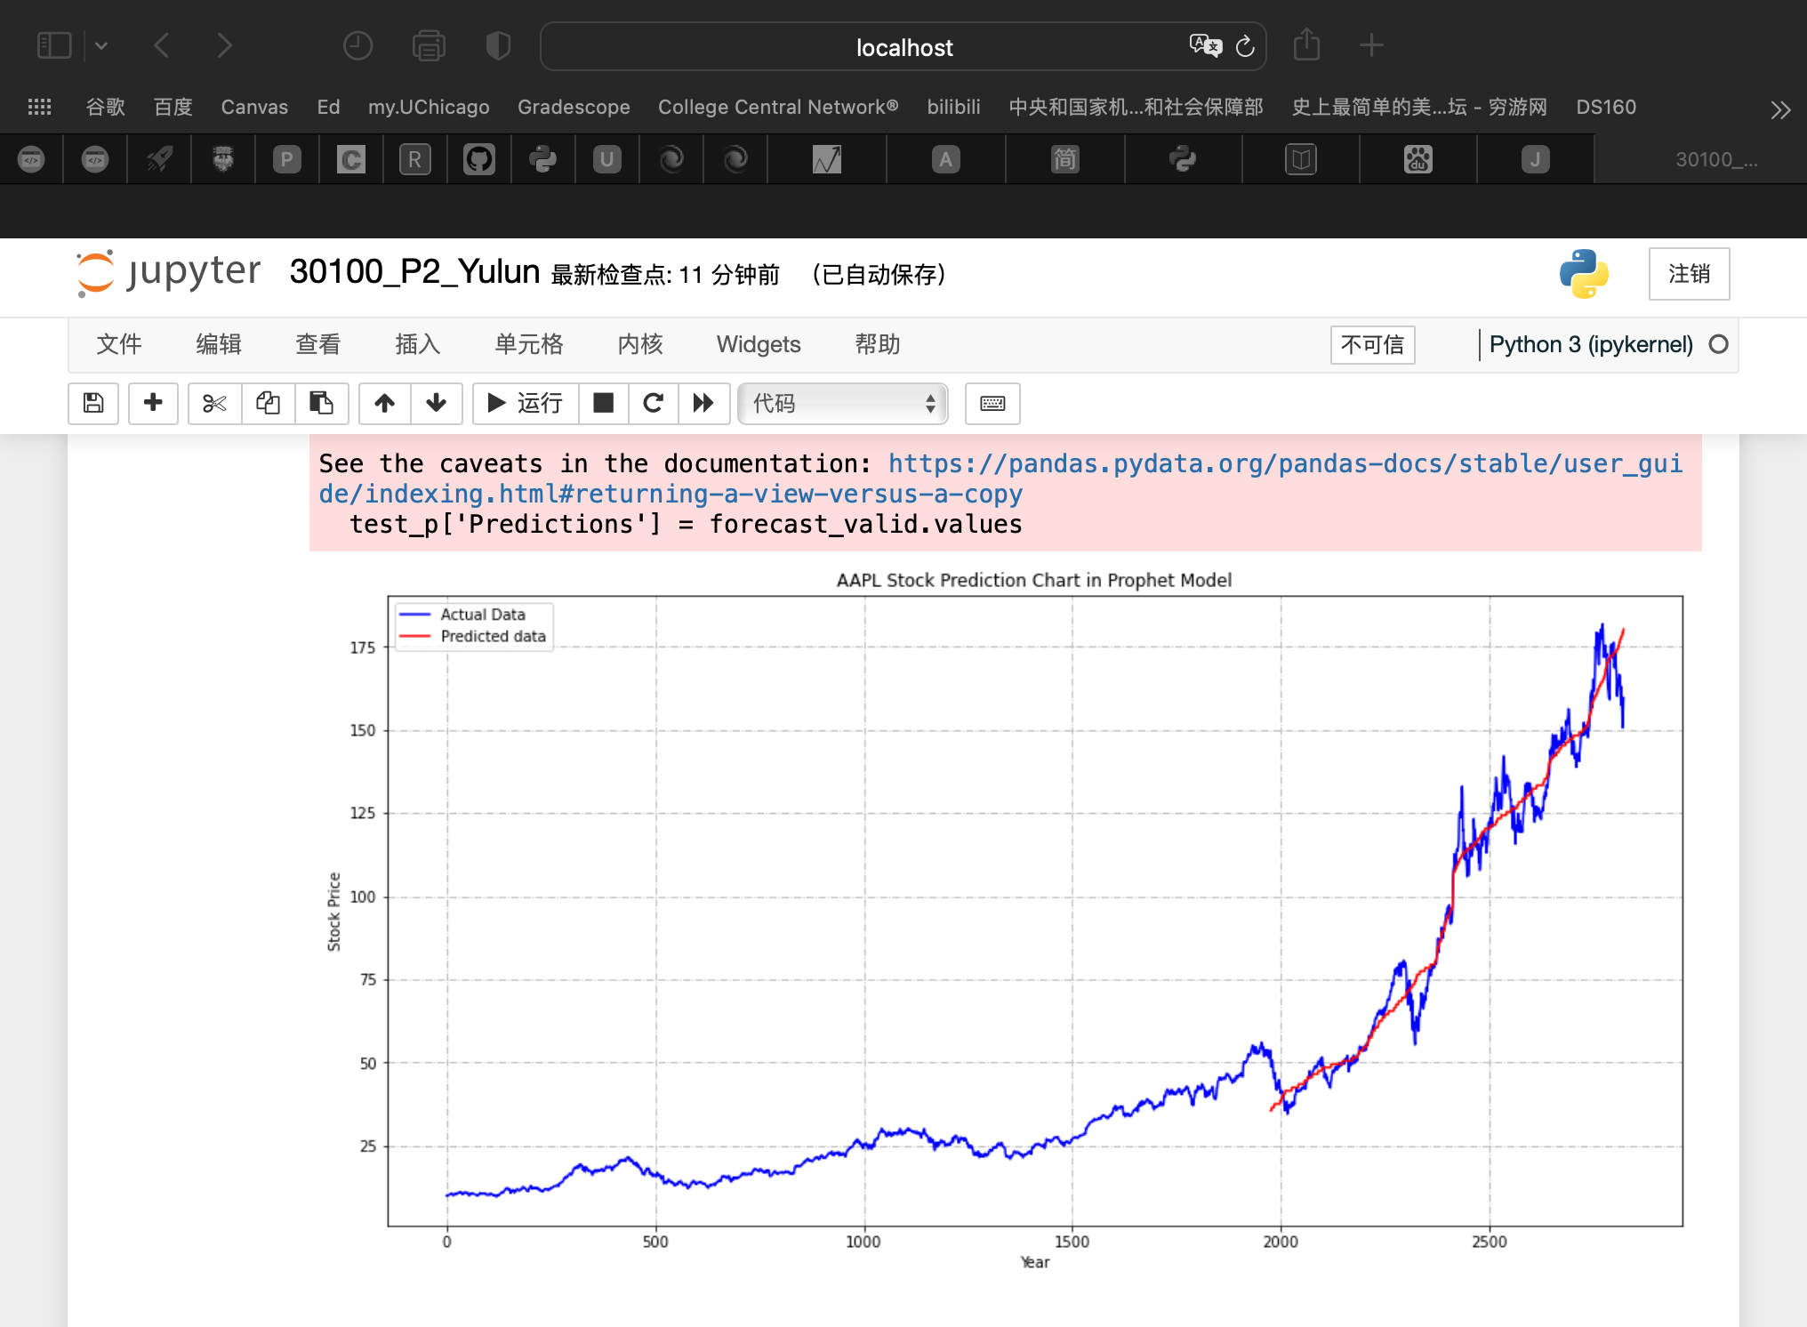
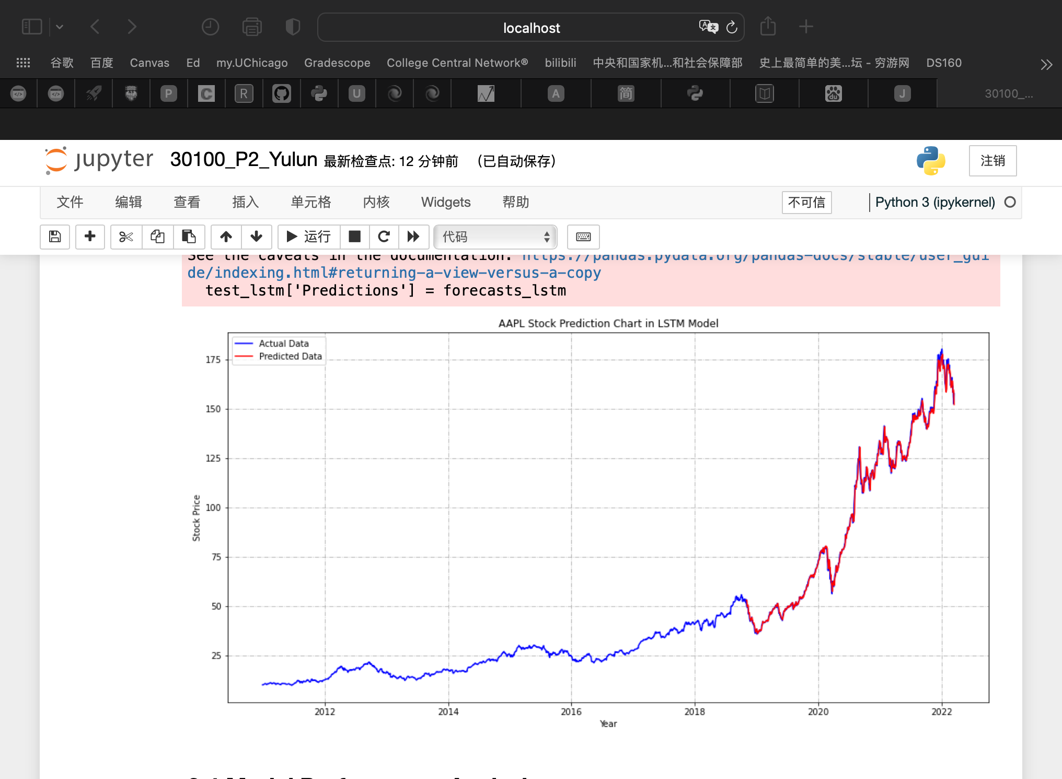
Prediction Chart Comparison
Linear Regression
Prophet
LSTM
Notes:
for data visualizaion
i plot prediction charts for each model
so we can have a remarkable insight for those three models

Slide 9
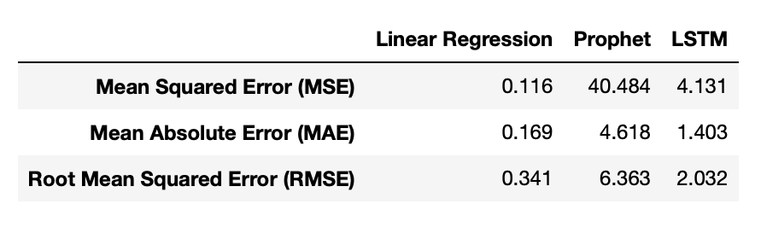
Error Analysis
Linear Regression has the lowest MSE, MAE and RMSE
BEST performance
Error:
Prophet: stock prices do not have a particular trend/seasonality
LSTM: not enough to identify whether the stock price will increase/decrease
Solutions:
Sentiment analysis:
analyze Twitter posts
analyze news
Notes:
to analyze model performance, i compared error analysis for three models
and found out linear regression has the lowest mean squared error, mean absolute error and root mean squared error.
so linear regression model has the best performance in stock price prediction
the error of Prophet, i think prophet tries to capture the trend and seasonality from past data. This model usually performs well on time series datasets, but fails in this case
As it turns out, stock prices do not have a particular trend or seasonality. It highly depends on what is currently going on in the market. so, forecasting techniques like Prophet would not show good results for this particular problem.
for The LSTM model, it can be tuned for various parameters such as changing the number of LSTM layers, adding dropout value or increasing the number of epochs. But the predictions from LSTM are not enough to identify whether the stock price will increase or decrease
well i think, stock price is affected by the news about the company and other factors like merger or demerger of the companies. There are certain intangible factors as well which can often be impossible to predict beforehand.
To improve the model performance, I think sentiment analysis is a good method. For example, I might use this method to analyze Twitter or Facebook posts and reviews for the subject company. Also analyze financial news about the company

Slide 10
Result Analysis
Task 1:
The EMA method is more adequate to predict stock price
Lower mean absolute error
Task 2:
The Linear Regression model has the best performance
Root mean squared error is the lowest in three models
Notes:
For result of task one and task two
For the first task, Based on linear regression model analysis, I found out the mean absolute error of EMA is lower than SMA's, and It means that EMA method is more adequate to predict stock price.
For the second task, Based on Task 1 analysis result, I applied EMA as feature into models.
Compared with three models' error analysis results, the Linear Regression model has the best performance, because its root mean squared error is the lowest among three models.

